Slide 1

How to Really use perplexity ai

Slide 2
What is covered
What is Perplexity AI?
Getting Started
A Tour of the Environment
Quick Search (Free)
The Importance of Good Prompts
Understanding Threads
Understanding Collections
Using Focus
Working with Attachments
Pro Search (Paid)

Slide 3
Quick Search

Slide 4
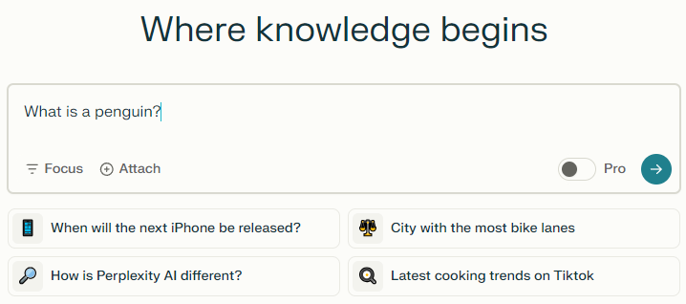
Notes:
What is a penguin?

Slide 5
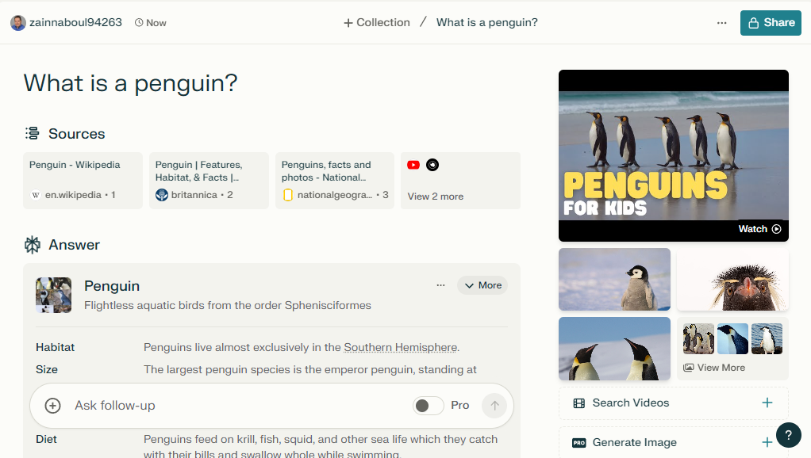

Slide 6
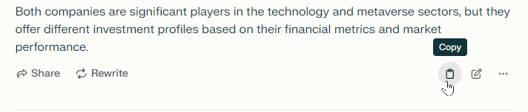
Working with the output

Slide 7
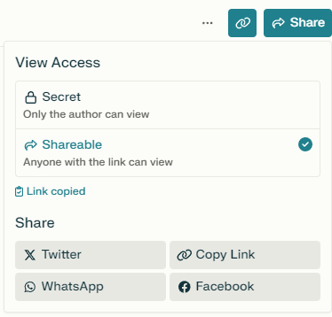
Sharing the output

Slide 8
The importance of good prompts

Slide 9
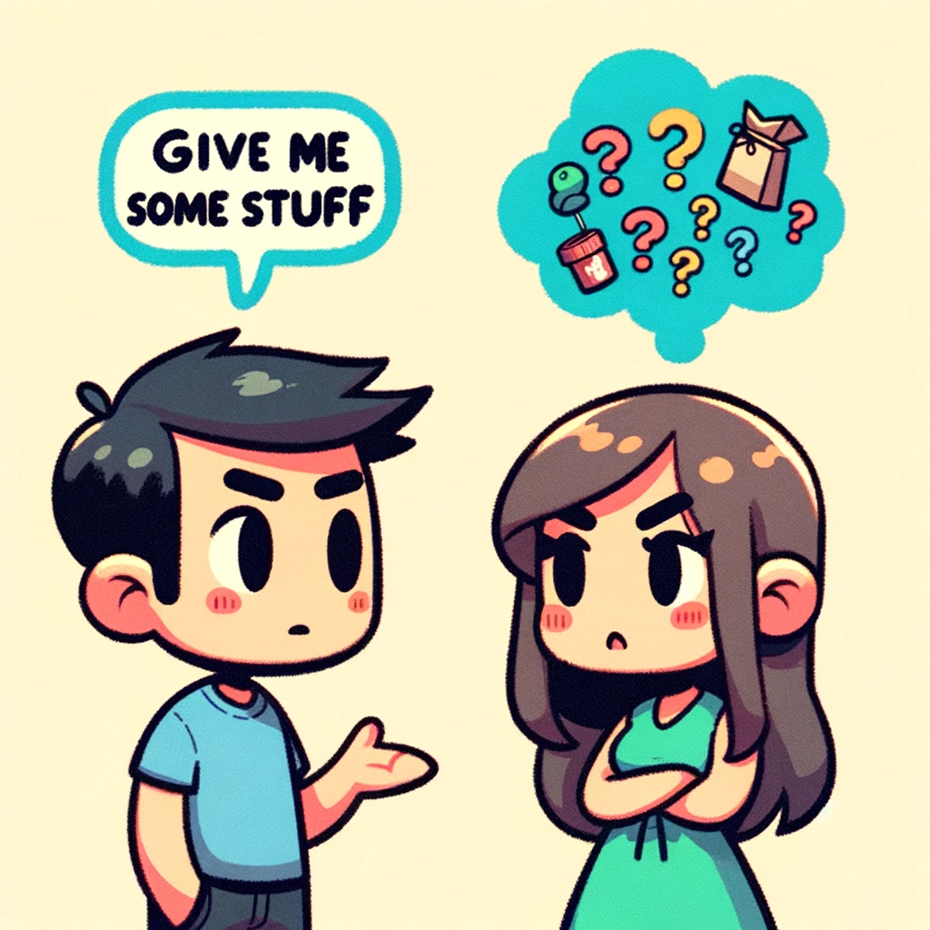

Slide 10
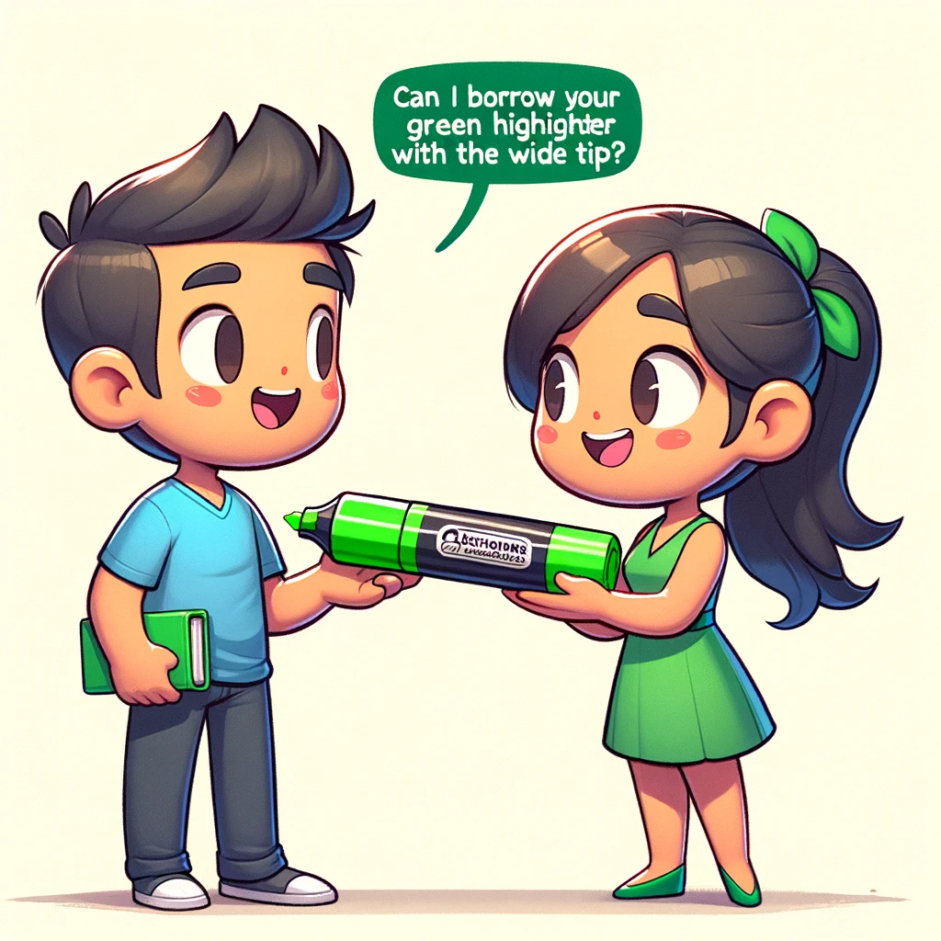

Slide 11
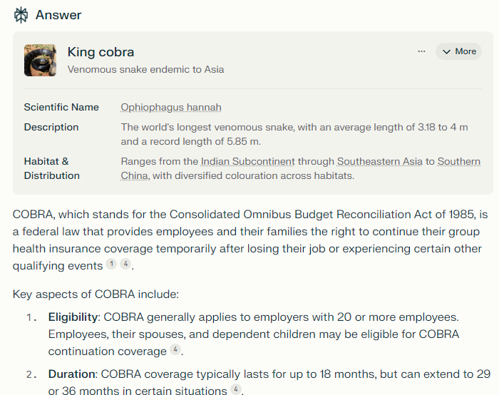
Getting confused
Notes:
What is a cobra?

Slide 12
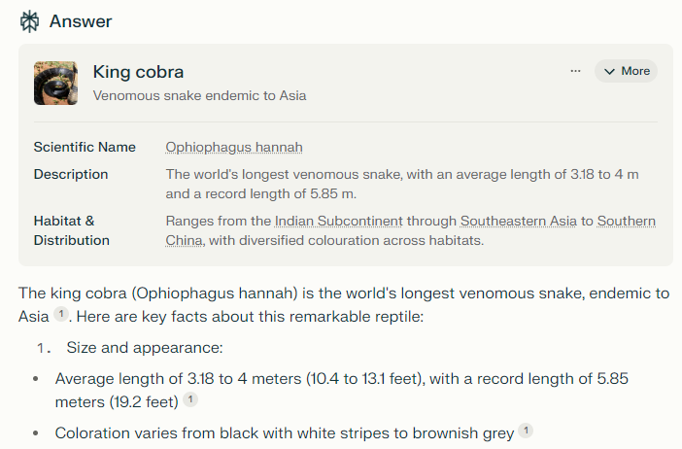
Being Precise
Notes:
What is a king cobra?

Slide 13




Notes:
https://www.youtube.com/channel/UC35ZpwldGw7ZJ5R-2sLijzw

Slide 14
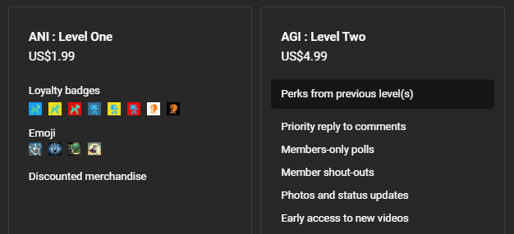

Membership has its privileges
Notes:
https://www.youtube.com/channel/UC35ZpwldGw7ZJ5R-2sLijzw/join

Slide 15

https://www.youtube.com/@AINewsFresh

Slide 16
Understanding threads

Slide 17
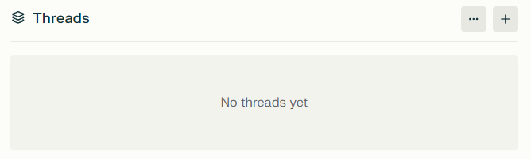

Slide 18
Understanding collections

Slide 19
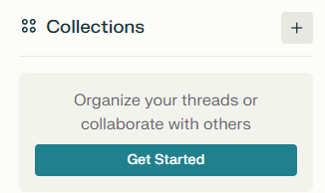

Slide 20


